Slide 1


PROJECT 2 REAL ESTATE Business Analytics
Presented by:

Slide 2

TABLE OF CONTENTS
1
Introduction
Research Objective
2
Data Understanding
Data Preparation
3
Key Performance Indicators (KPIs)
Dashboard creation
4
Key Insights
Recommendations
2

Slide 3
INTRODUCTION
This presentation showcases my final Real Estate Analytics Project, emphasizing my Power BI and data visualization skills as part of my professional portfolio.
Successfully completed as part of a data-driven initiative, this project combines hands-on learning with real-world applications to enhance property insights and optimize decision-making processes.
Developed an interactive Power BI dashboard to analyze key metrics, including property trends, market performance, and customer preferences. The dashboard provides actionable insights to identify investment opportunities, streamline property management, and understand market dynamics.
The project covers every stage of the business analytics process — from defining the real estate challenges to transforming raw data into visually compelling, data-driven insights.
A practical demonstration of leveraging analytics to address real-world challenges in the real estate sector!
3

Slide 4
RESEARCH OBJECTIVE
Accurate property valuation is essential for informed decision-making in the real estate industry. Buyers, sellers, investors, and real estate professionals depend on reliable valuation estimates to determine fair market prices, negotiate deals, and assess investment opportunities.
BUYERS & SELLERS
INVESTORS
REAL ESTATE AGENTS
UNDERSTAND PRICE TRENDS
IDENTIFY LUCRATIVE OPPOTUNITIES
TRACK MARKET PERFORMANCE
Accurate pricing helps buyers make informed decisions
Investors use market trends to identify profitable deals.
Real estate prices fluctuate due to location, property type, and lease duration.
4

Slide 5
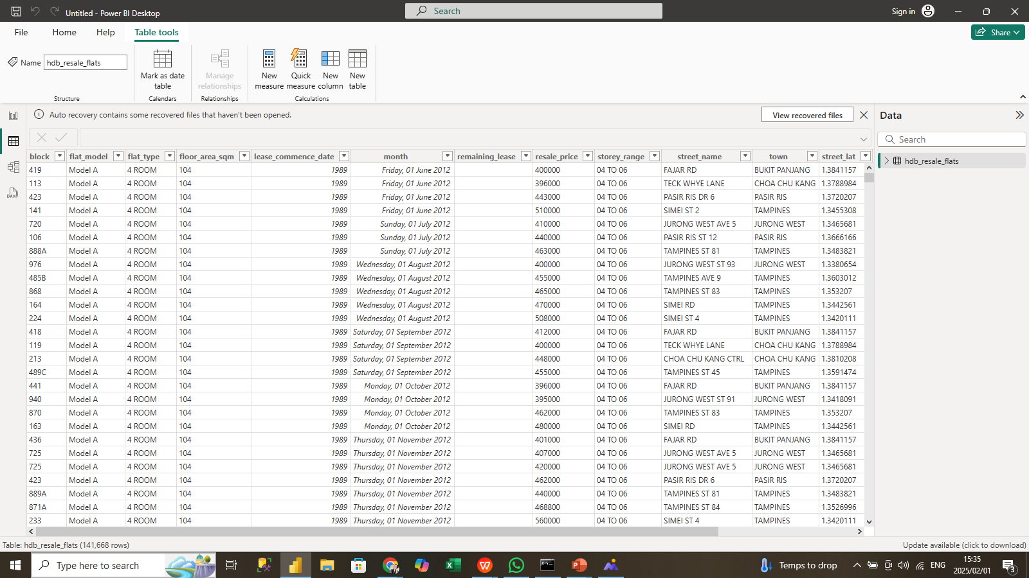
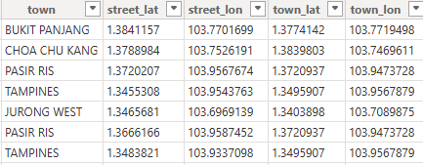
DATASET OVERVIEW
The dataset consists of 141,668 rows and 15 columns, including:
Property Information: block, flat_model, flat_type, floor_area_sqm, storey_range
Lease Info: lease_commence_date, remaining_lease.
Market Data: resale_price, month
Geographic Info: town, street_name, street_lat, street_lon
5

Slide 6
DATA CLEANING AND PREPARATION
month is in string format; should be converted to date.
Create property_age column.
remaining_lease has missing values (~37% of data).
Create measures to provide information across columns
6

Slide 7
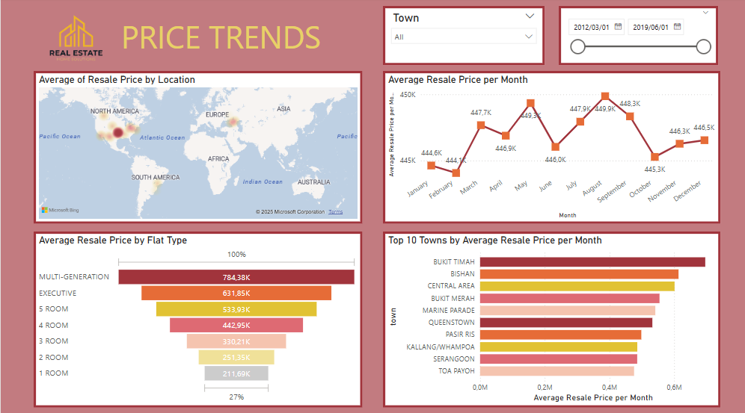
PRICE TRENDS DASHBOARD
7

Slide 8
PRICE TRENDS
RESALE PRICES SHOW SEASONAL TRENDS
LOWER-PRICED TOWNS OFFER AFFORDABLE HOUSING
Fluctuations in average resale price per month indicate possible seasonal effects.
Prices peak around March–June and decline towards September–December.
Areas like Pasir Ris, Kallang/Whampoa, and Serangoon show moderate to low resale prices.
These locations may be more attractive for first-time homebuyers or investors looking for lower-priced properties.
TOP LOCATIONS WITH HIGHEST PRICES
LARGER FLATS COMMAND HIGHER PRICES
Bukit Timah, Bishan, and Central Area have the highest resale prices.
These areas might have high demand due to better facilities, location, and amenities.
Multi-generation, Executive, and 5-Room flats have the highest average prices.
Smaller flats (1-room & 2-room) tend to be more affordable but are less in demand.
8

Slide 9
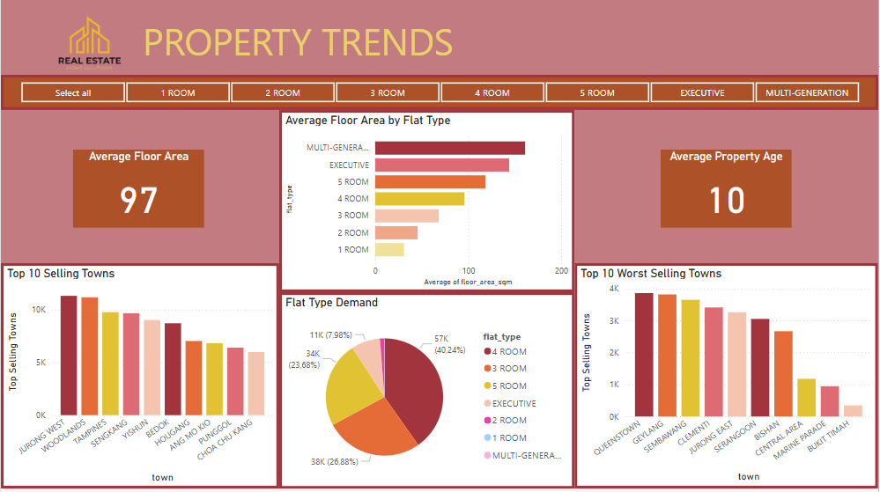
PROPERTY TRENDS DASHBOARD
9

Slide 10
PROPERTY TRENDS
AVERAGE FLOOR AREA & PROPERTY AGE
MOST & LEAST POPULAR TOWNS
FLAT TYPE DEMAND
The average floor area of sold flats is 97 sqm, indicating mid-sized units are most common.
The average property age is 10 years, suggesting many newer resale transactions.
Jurong West, Woodlands, Tampines, and Sengkang have the highest sales volume.
Queenstown, Bukit Timah, and Marine Parade have lower transaction volumes, possibly due to higher prices or limited available units.
4-room flats dominate the market, accounting for 40% of total sales.
3-room and 5-room flats are also in high demand.
Smaller units (1-room & 2-room) have significantly lower demand.
10

Slide 11
RECOMMENDATIONS
REAL ESTATE AGENTS
INVESTORS
BUYERS & SELLERS
Affordable options in Pasir Ris & Serangoon.
Larger families should focus on 5-room/executive flats.
Investment areas: High-growth towns like Bukit Timah & Bishan.
Smaller flats (1-room & 2-room) might be better for rental yield, targeting single professionals and students.
Focus on newer properties (~10 years old) for better long-term value..
Young professionals → Smaller flats in central locations.
Families → Larger flats in suburban areas.
Seasonal Selling Strategy: Encourage listings in early Q2 (March–June) when prices are highest.
11

Slide 12
THANK YOU!
12

